Slide 1
Shapeoko 2 ft. myrio
Mechatronica: meet- en regeltechnieken
Glenn Kerselaers
Devlin Voets

Slide 2
Presentation overview
Assemblage
Electronics
Workflow
RE gShield
myRio
Interface PCB
LabVIEW
DEMO

Slide 3
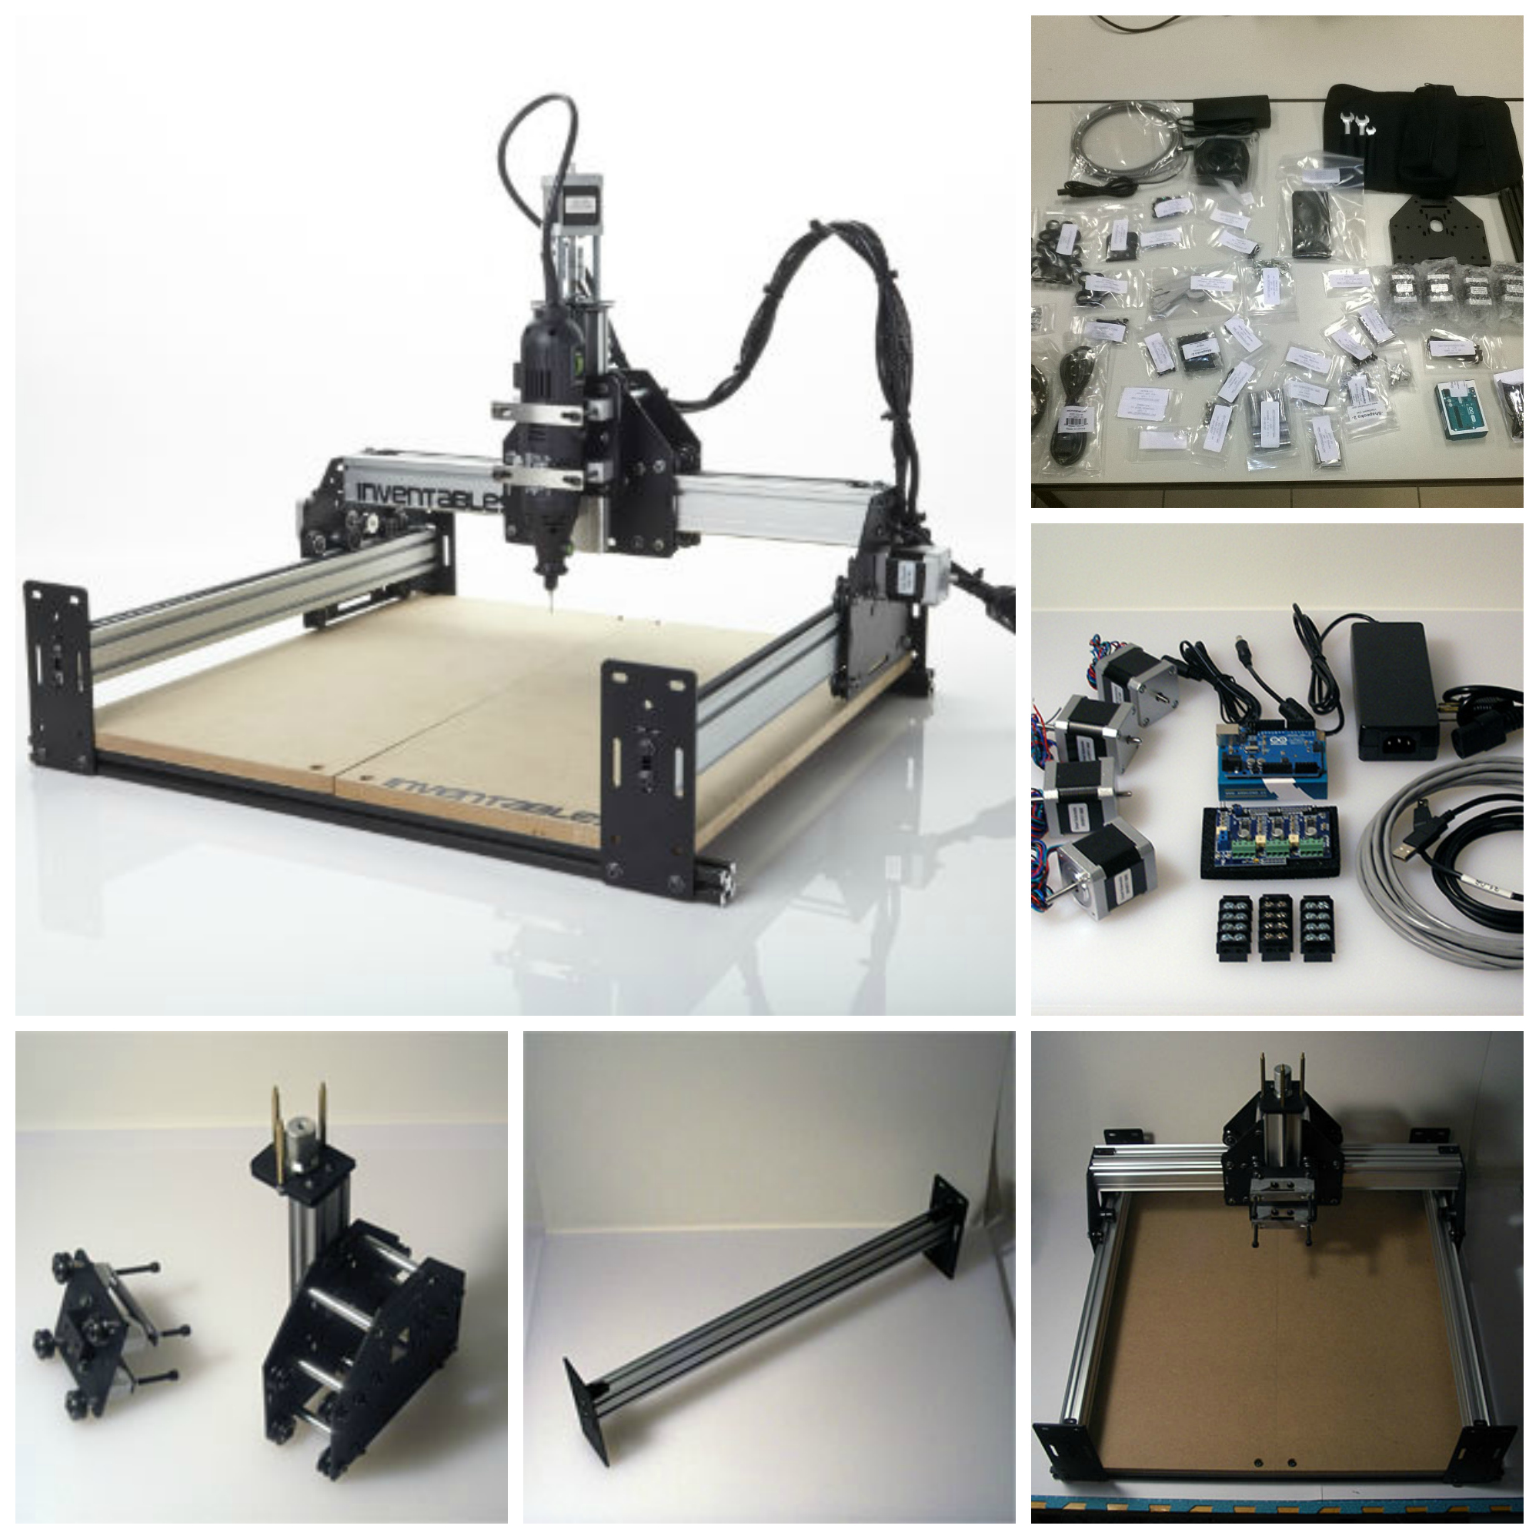
assemblage

Slide 4
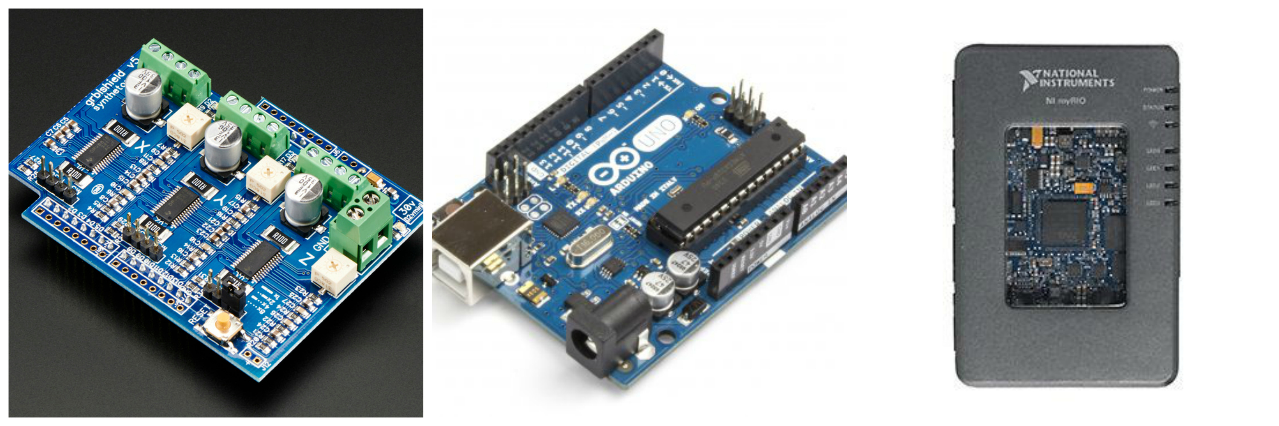
electronics

Slide 5
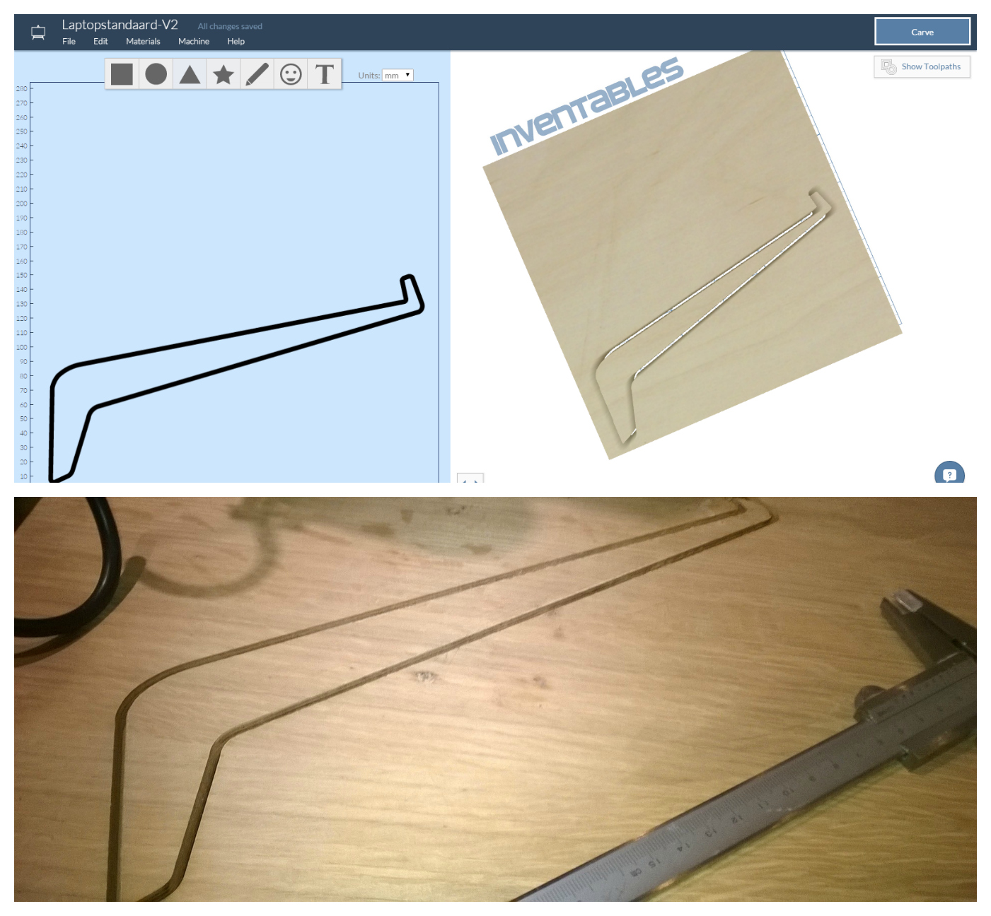
workflow
Tools:
Autocad
Inkscape
Easel
…

Slide 6
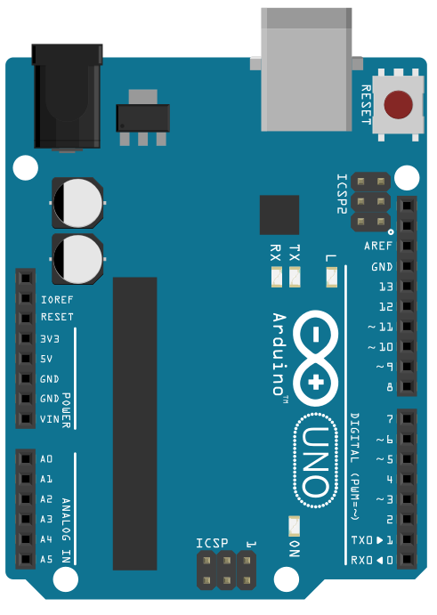
Reverse engineering gshield
D13: Spindle Direction
D12: Spindle Enable
D11: Limit Z-axis
D10: Limit Y-axis
D09: Limit X-axis
D08: Stepper enable
D07: Direction Z-axis
D06: Direction Y-axis
D05: Direction X-axis
D04: Step Pulse Z-axis
D03: Step Pulse Y-axis
D02: Step Pulse X-axis

Slide 7
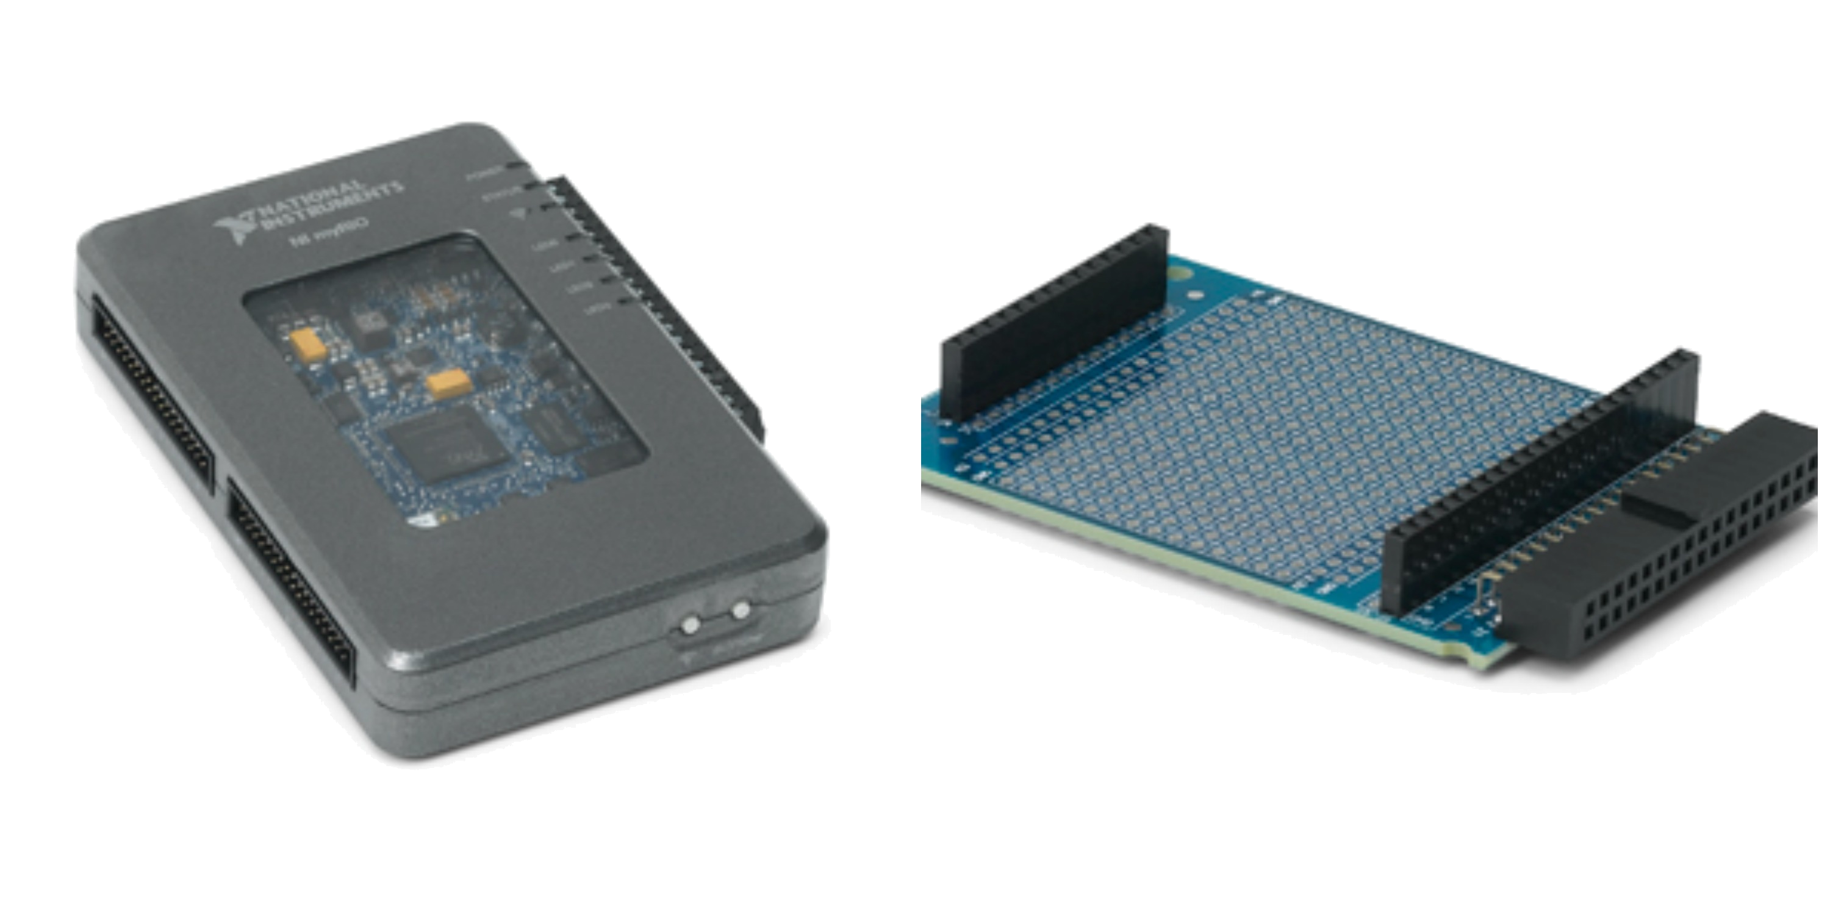
Ni myrio
LabVIEW myRIO 2013
MXP-connector Prototype shield
Wifi built-in
3 LEDs and 1 button

Slide 8
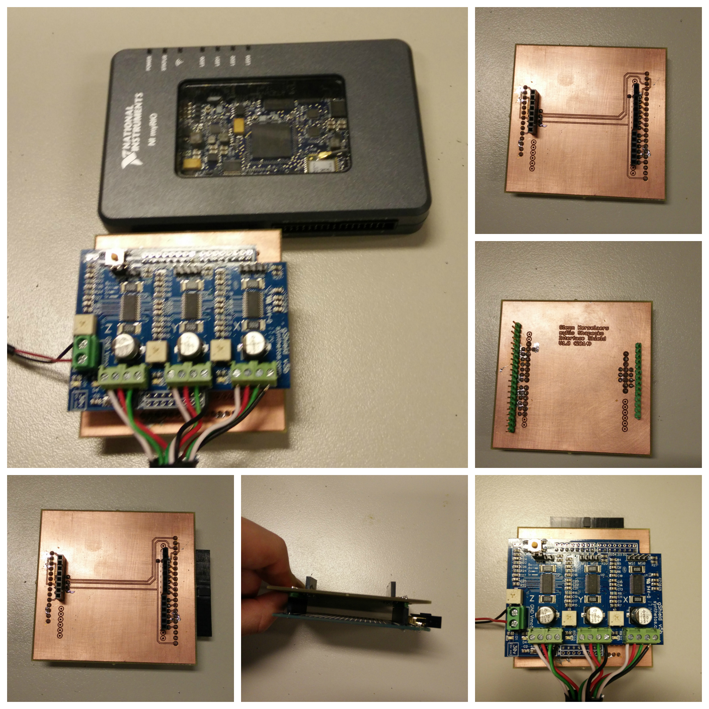
Interface pcb
Arduino Uno pinout to MXP prototype shield

Slide 9
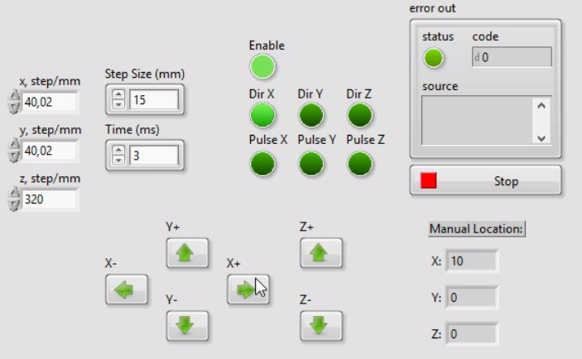
Labview – Front panel

Slide 10
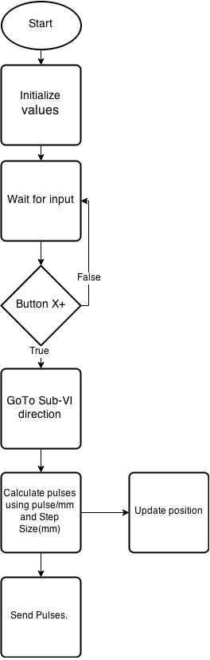
Labview – code Main VI

Slide 11
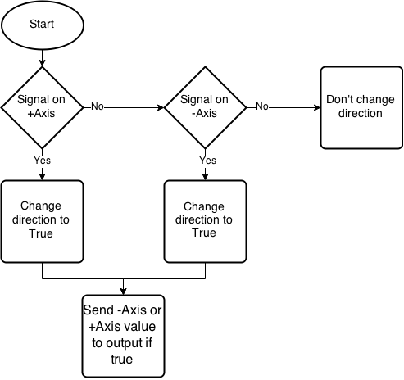
Labview – code Sub-VI DIrection

Slide 12

DEMO

Slide 13
What we see in the Maker Movement, is that a relatively small amount of people can have a big impact. You don’t necessarily need the world largest company behind you.
Dale Dougherty
Stichter en CEO van Maker Media en oprichter van Maker Faire, is één van de grootste Maker Movements voorstander

